Slide 1
What have we done?
Geoff Huston

Slide 2
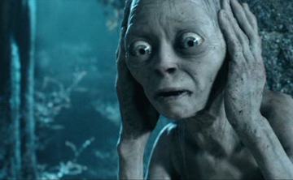

Slide 3
Around 25 Years Ago…
In 1990, Peter Elford and I switched on the Australian Academic and Research Network for every University and CSIRO site in Australia
The Internet had arrived for the Australian Higher Education and Research sector
So what were the issues then and how much have things changed…?

Slide 4
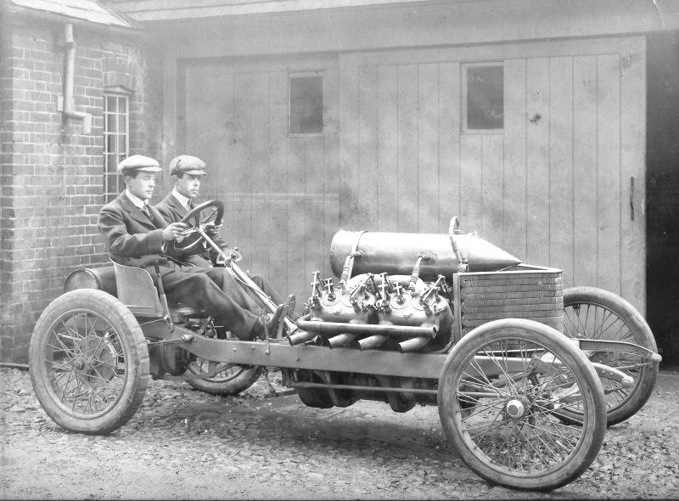
The past is a foreign land – they do things differently there!

Slide 5
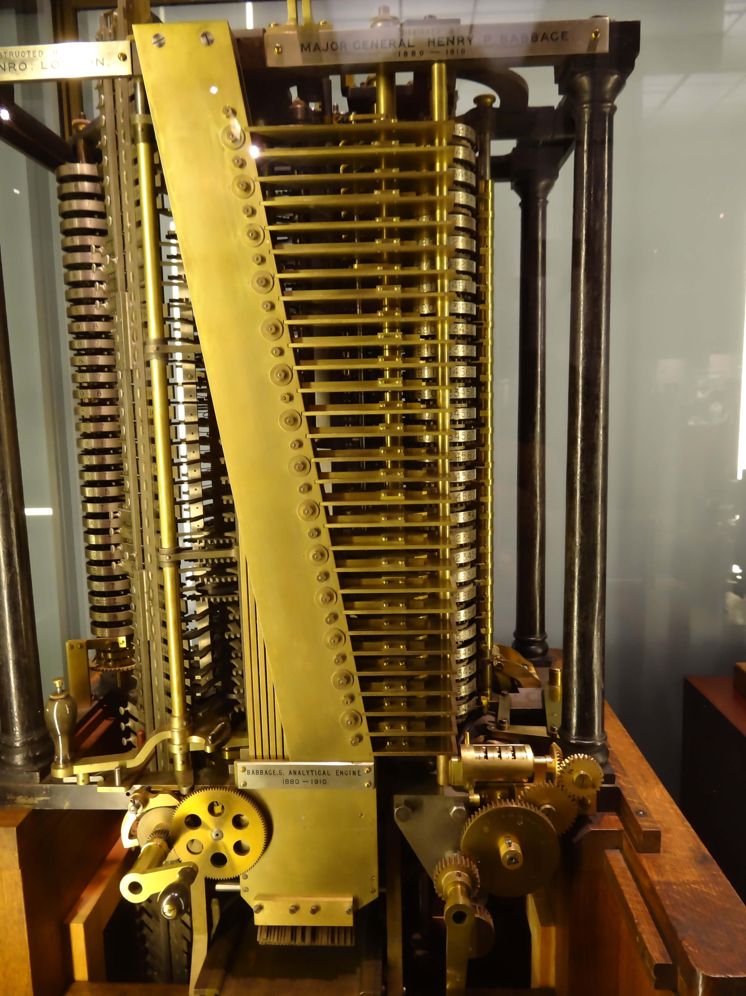
The Computing Evolutionary Path
1837 – Babbage’s Analytical Engine

Slide 6
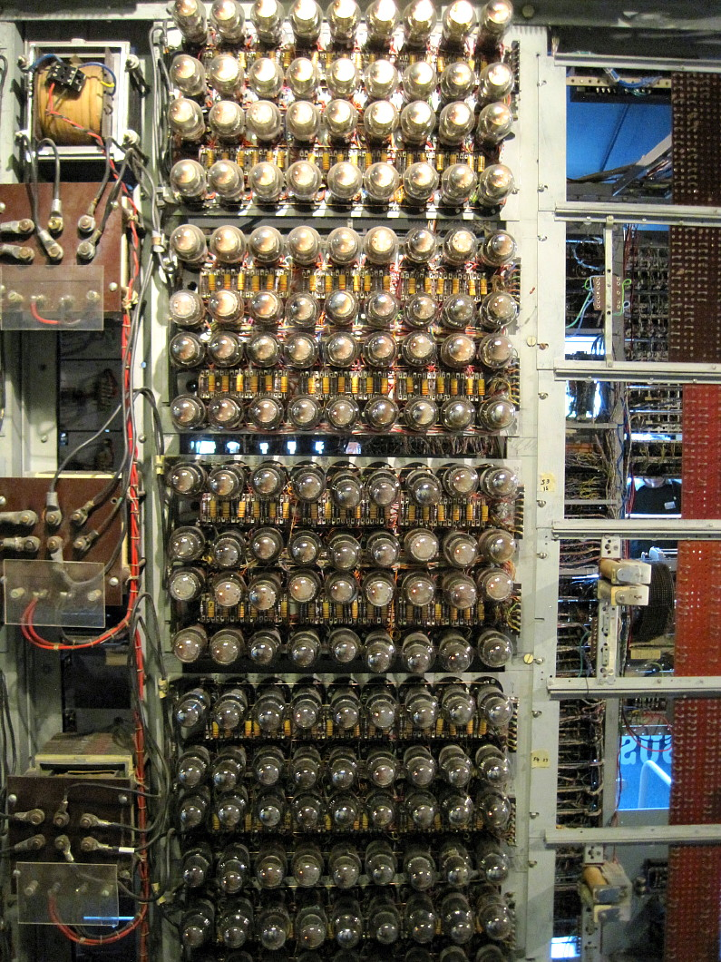
The Computing Evolutionary Path
1943 – Colossus Computer

Slide 7

The Computing Evolutionary Path
1946 – Eniac – a numeric calculator

Slide 8
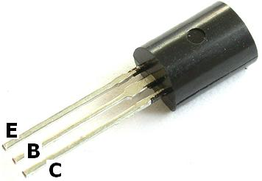
The Computing Evolutionary Path
1947– The Transistor

Slide 9

The Computing Evolutionary Path
1964 IBM 360 – commercial computing
1964: IBM 360

Slide 10

The Computing Evolutionary Path
The Computing Evolutionary Path
1976 CRAY-1 – “super” computing

Slide 11
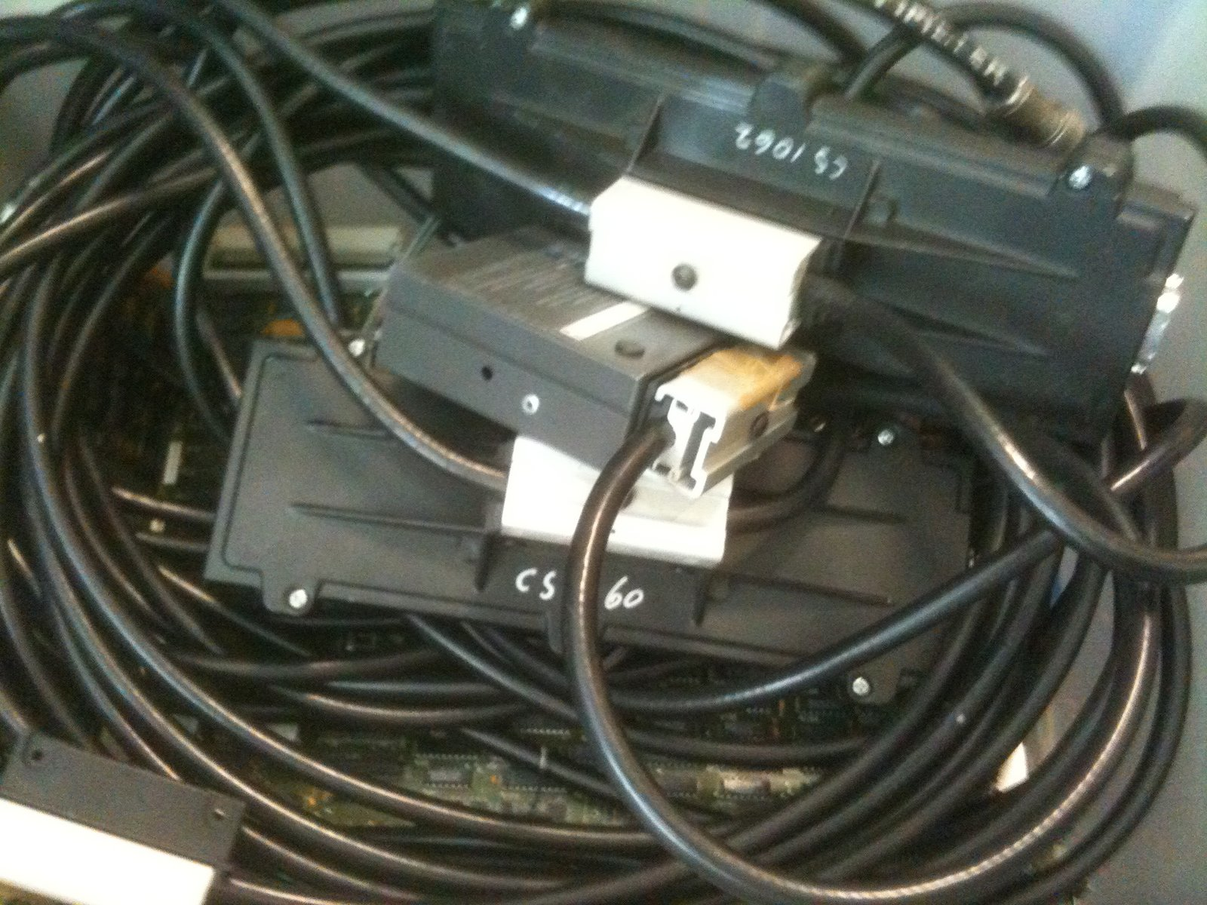
The Computing Evolutionary Path
1976 Ethernet

Slide 12
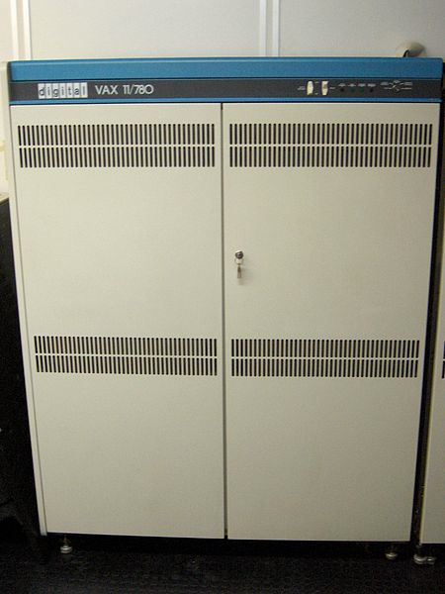
The Computing Evolutionary Path
The Computing Evolutionary Path
Wide Area Packet Networks
1982 – DECnet Phase IV

Slide 13

The Computing Evolutionary Path
1984 – Mac - visual computing

Slide 14
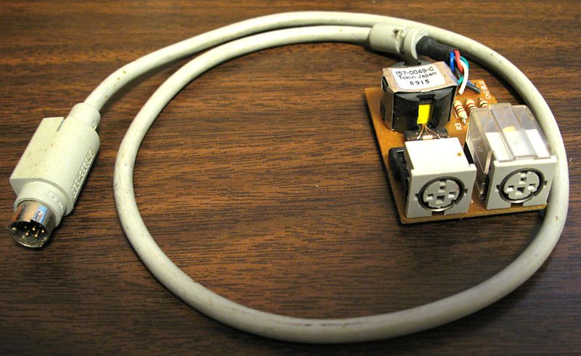
The Computing Evolutionary Path
1985 – Appletalk

Slide 15
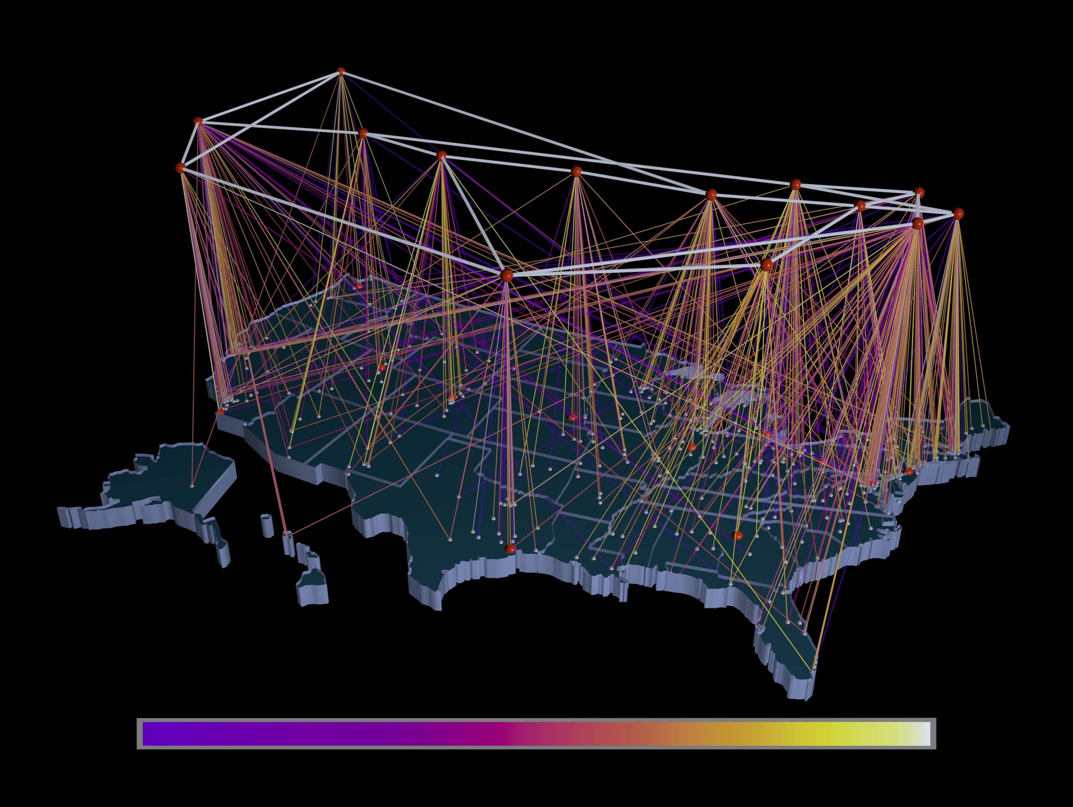
The Computing Evolutionary Path
1988 – TCP/IP and the NSFNET

Slide 16
Which brings us to 1990
(Or thereabouts)

Slide 17
What were we talking about then?

Slide 18
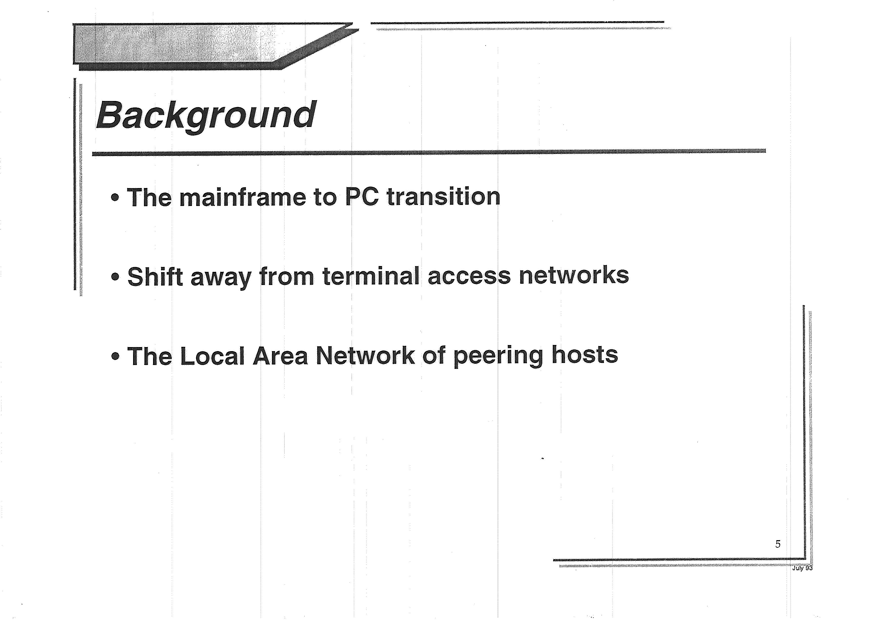

Slide 19
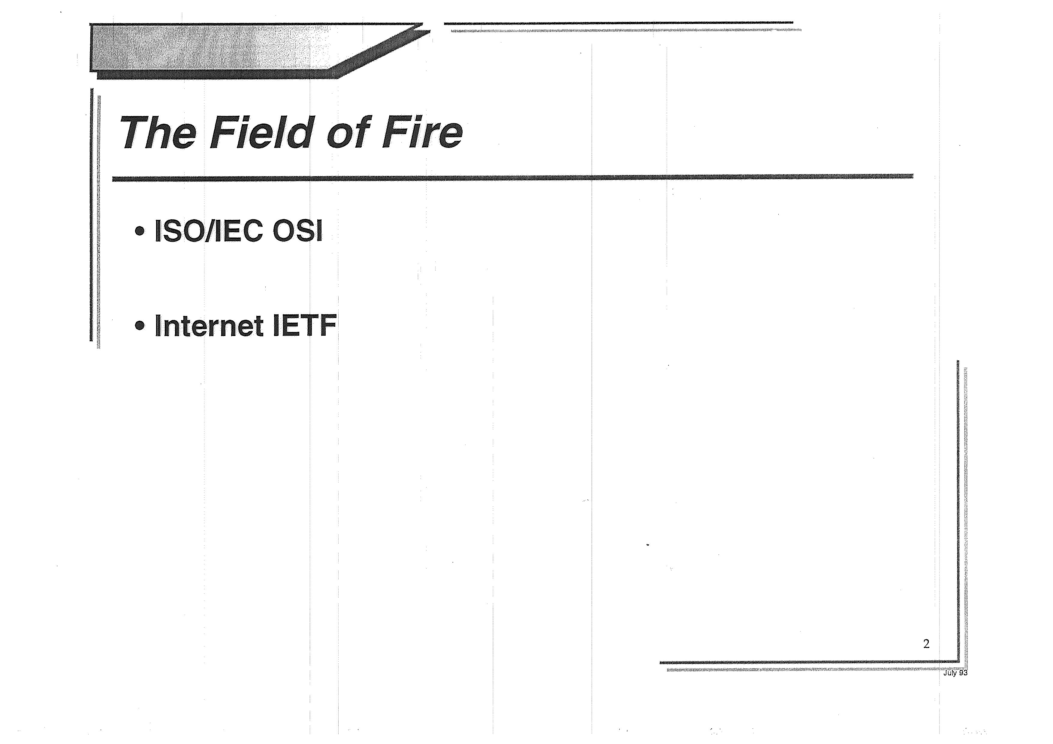

Slide 20
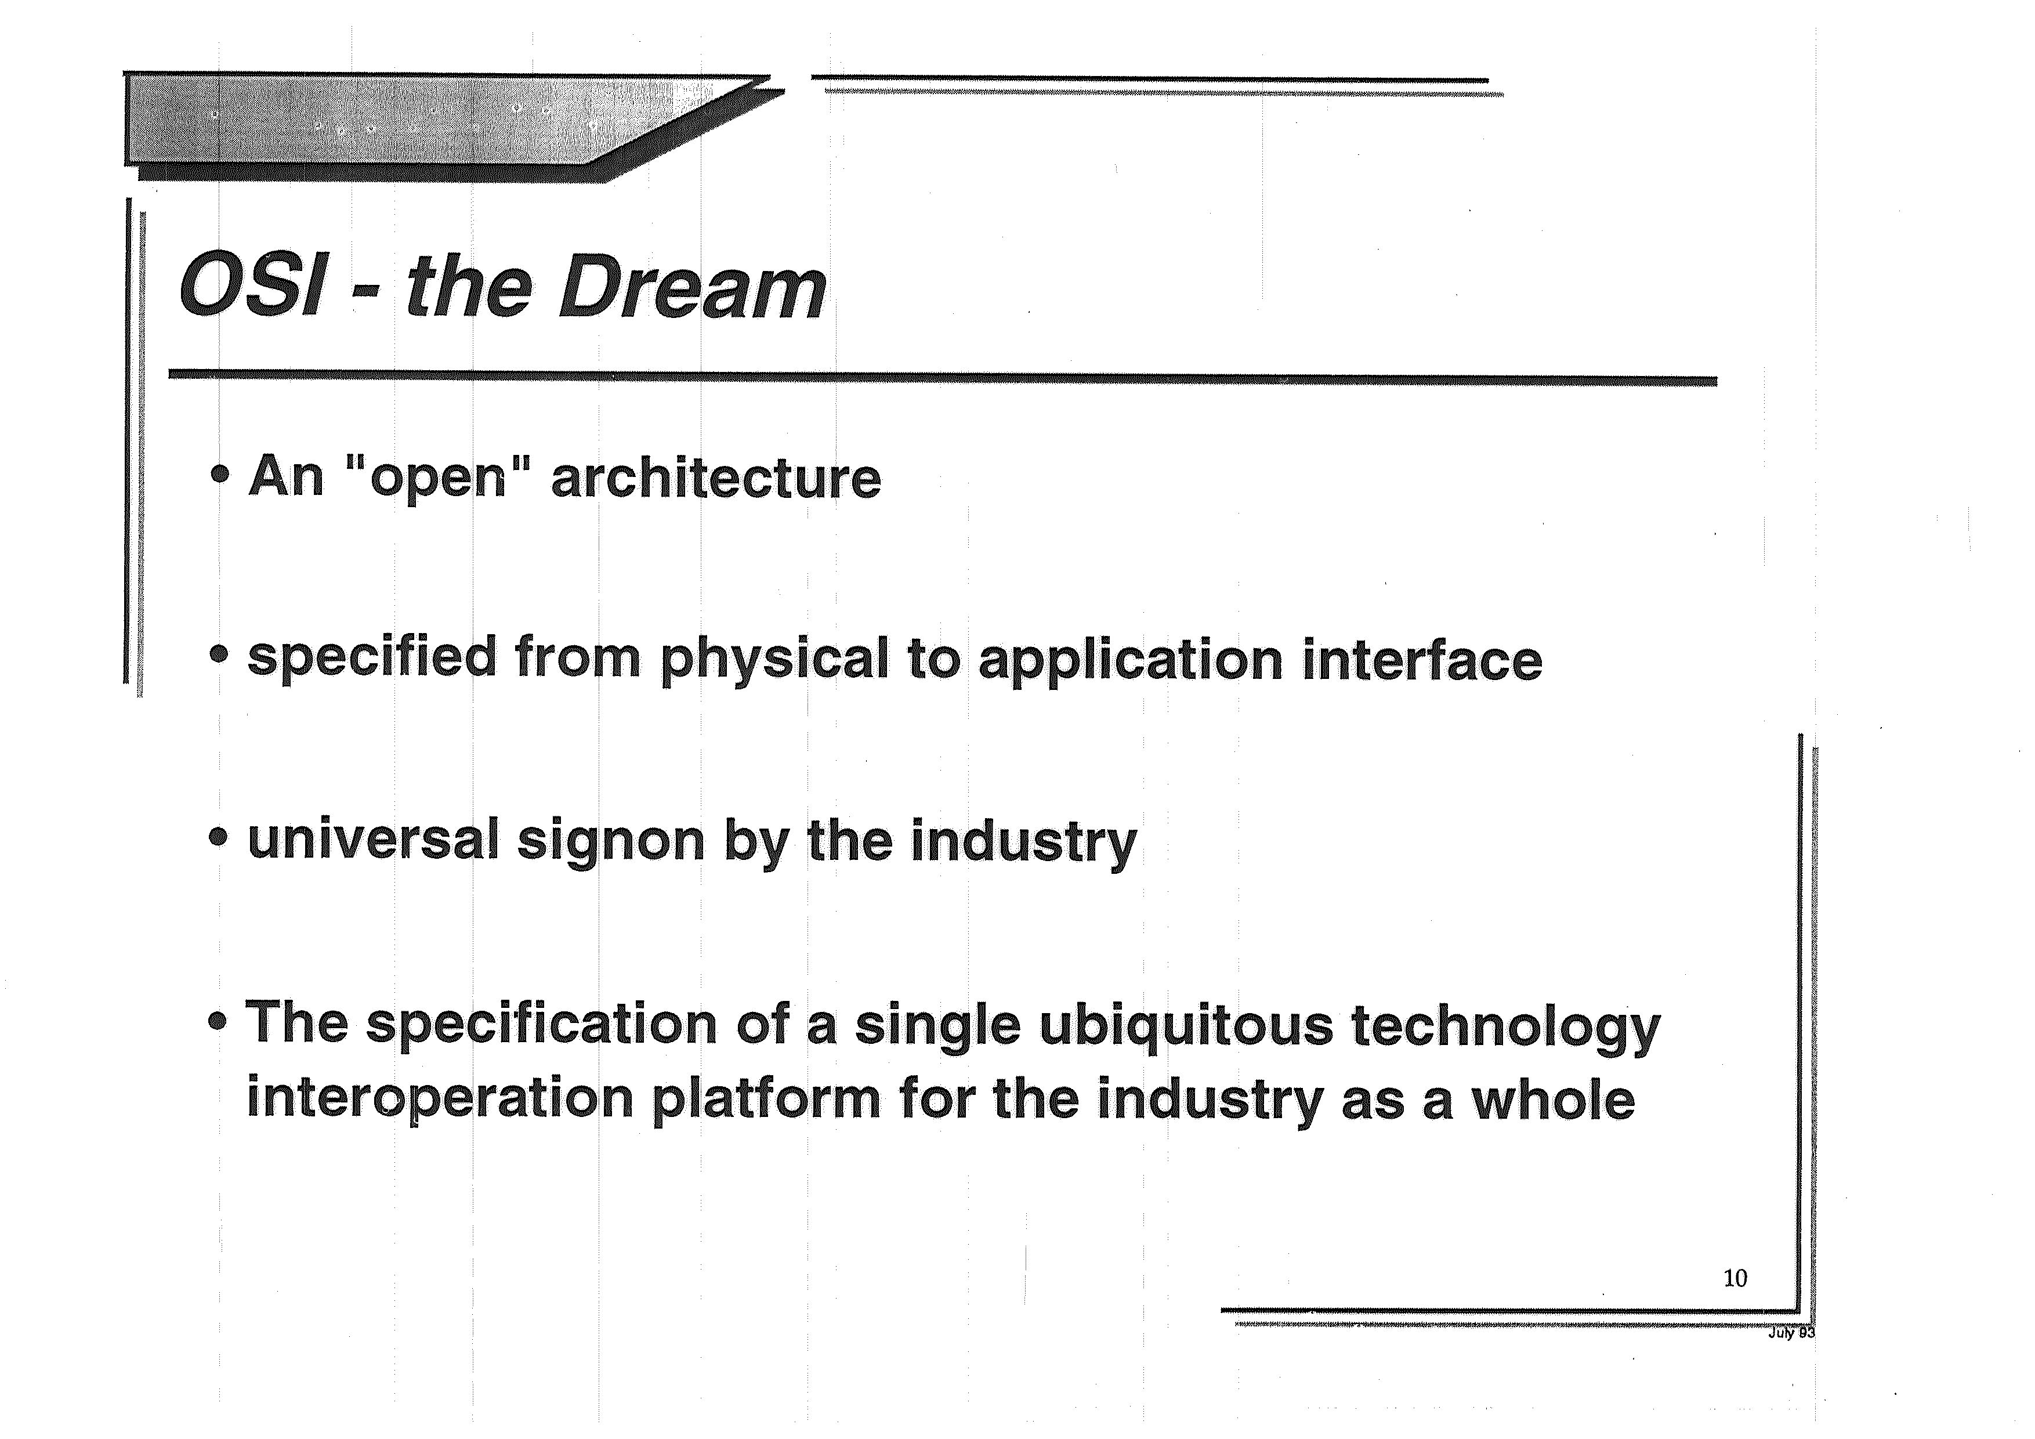

Slide 21
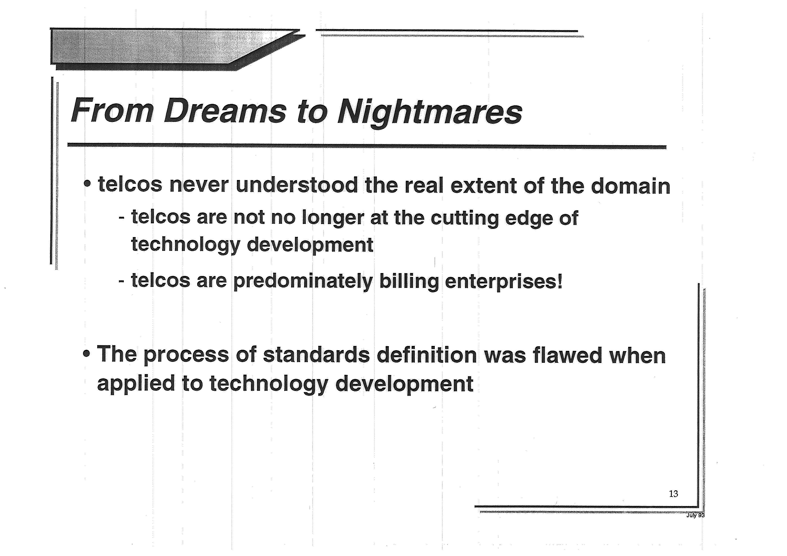

Slide 22
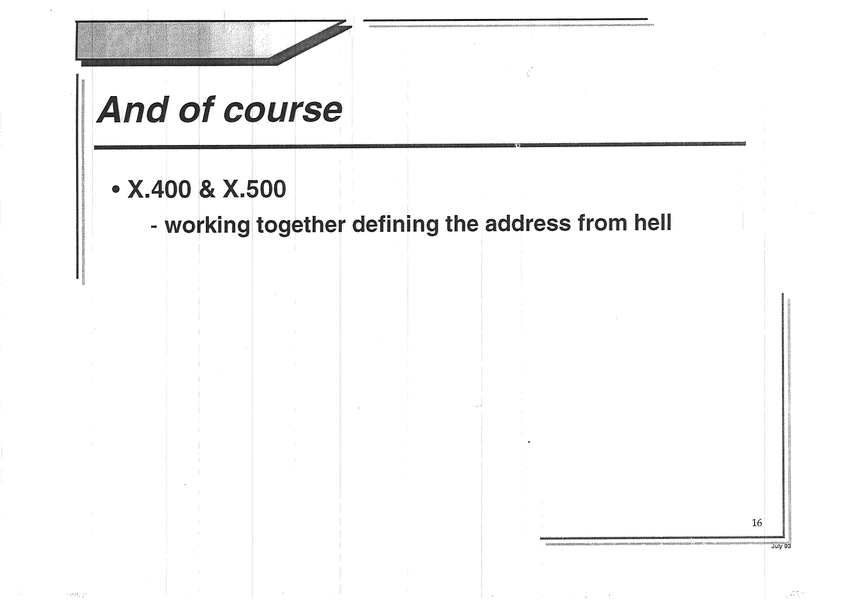

Slide 23
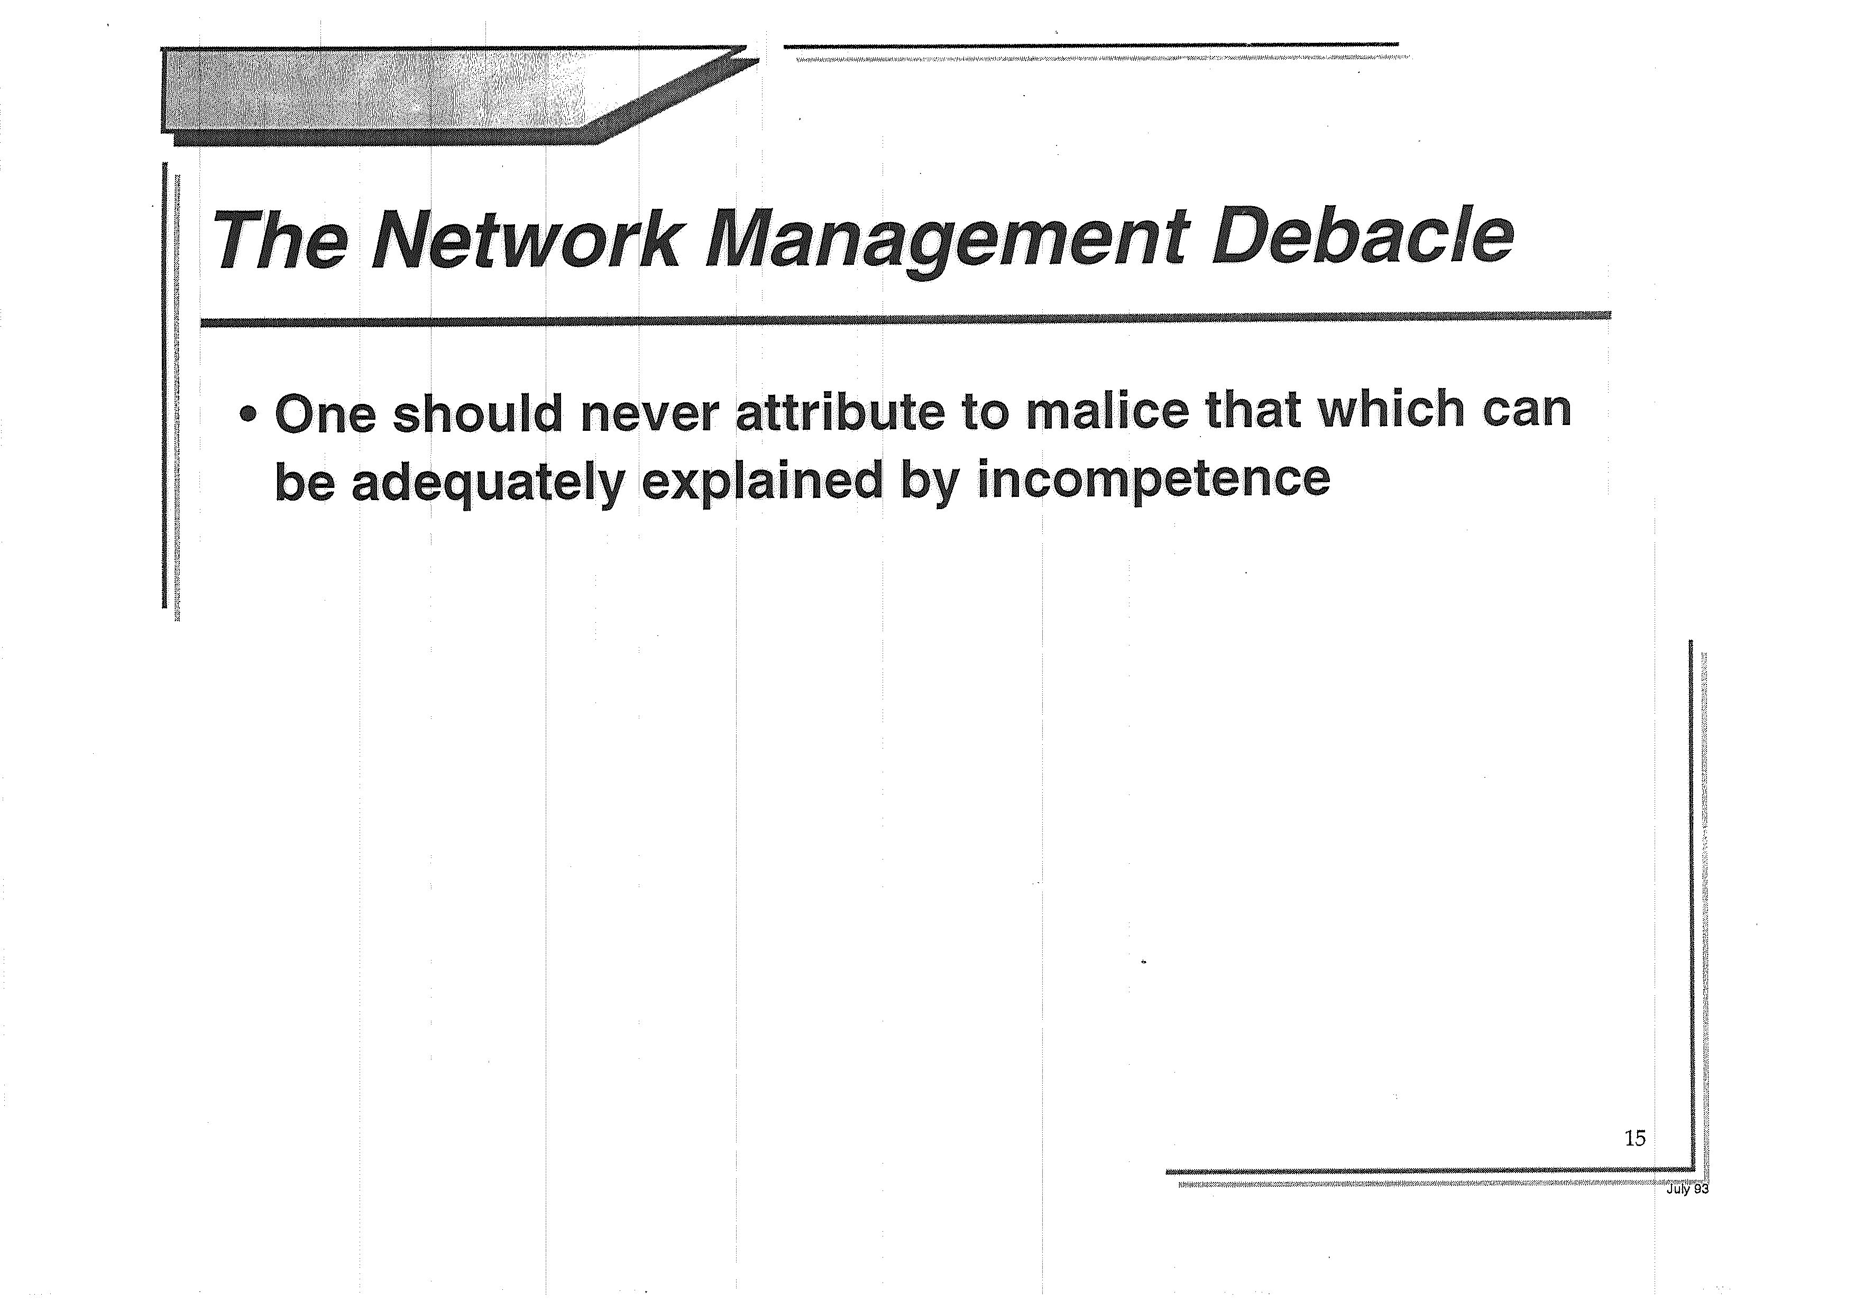

Slide 24
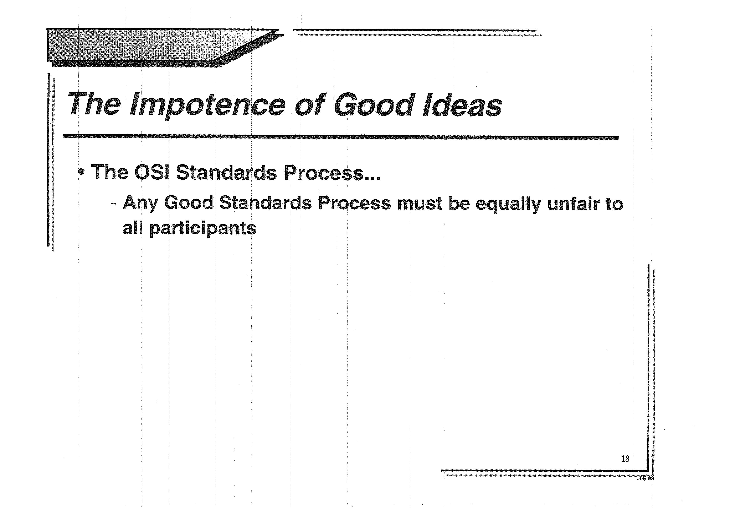

Slide 25
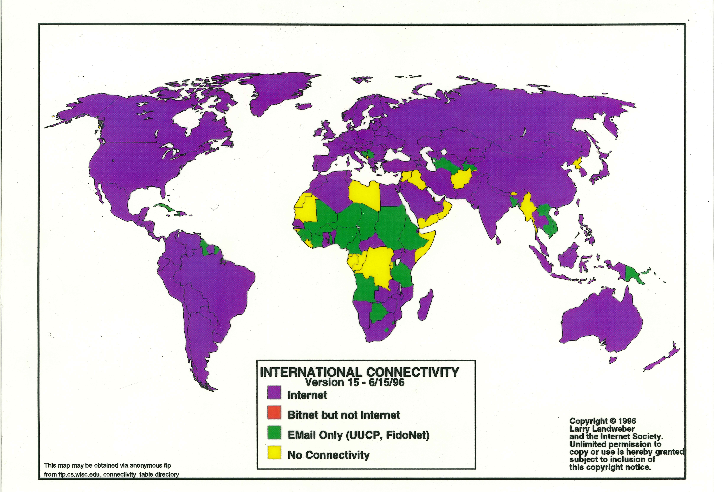
We had high hopes for the Internet

Slide 26
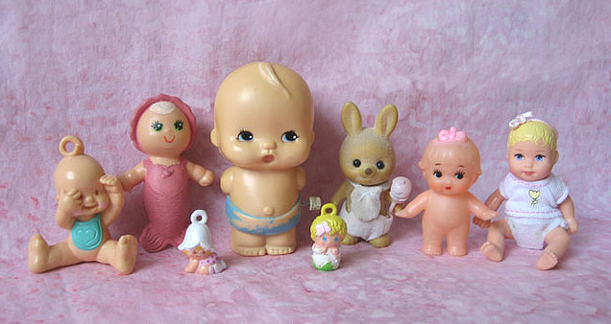
But we were a lot younger then
Photo Credit: Aimee Ray https://www.flickr.com/photos/merwing/516164481

Slide 27

And we were the underdog
Photo Credit: https://www.flickr.com/photos/barrielynn/1817195121

Slide 28
Things are different now

Slide 29
Things are different now
We won

Slide 30
Things are different now
We won:
We won the protocol wars with OSI
We won the voice wars with telephony
We won the content wars with television
Computers and the Internet are now everywhere…

Slide 31
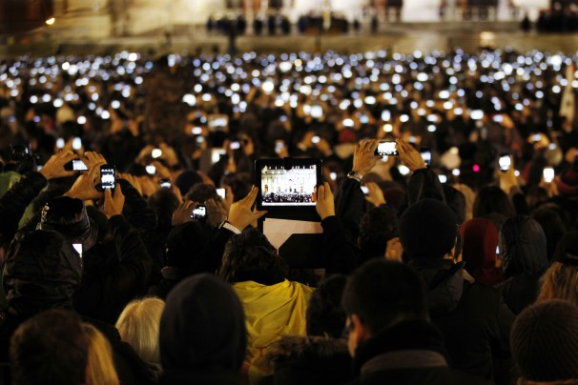
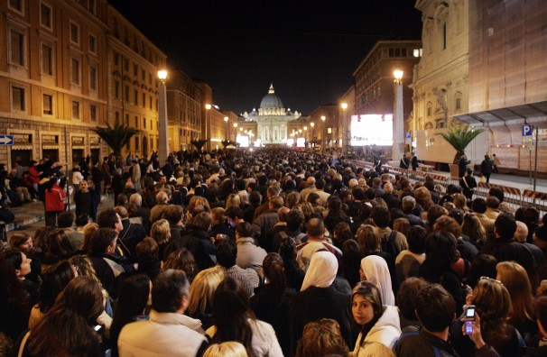
Recording everything
2005
2013

Slide 32
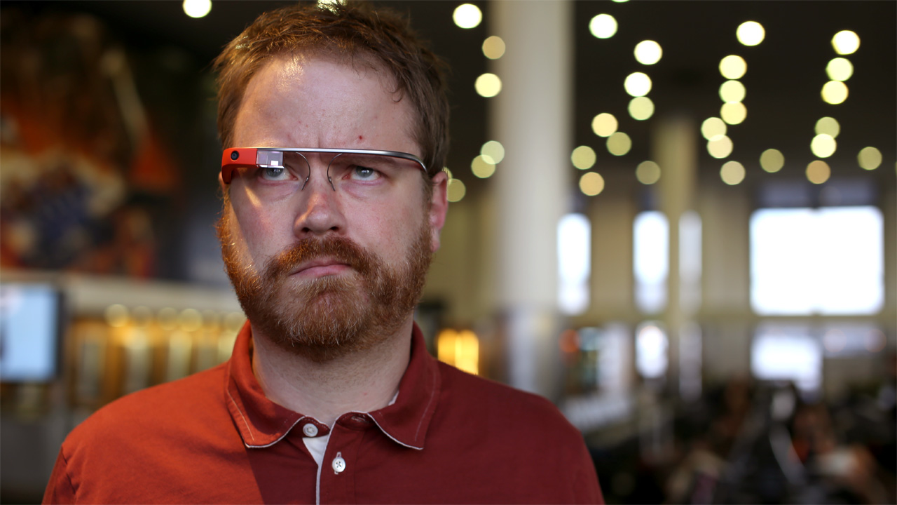
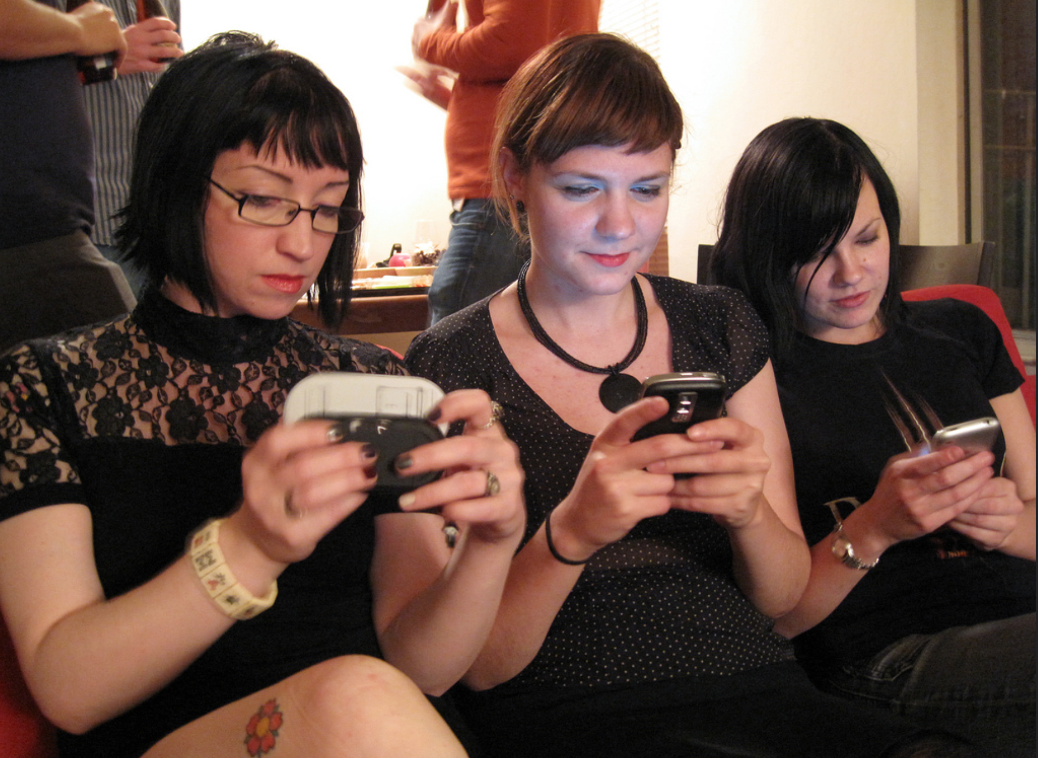
Always with us

Slide 33
And it sure looks like…

Slide 34
And it sure looks like…
WE are now the subject!

Slide 35
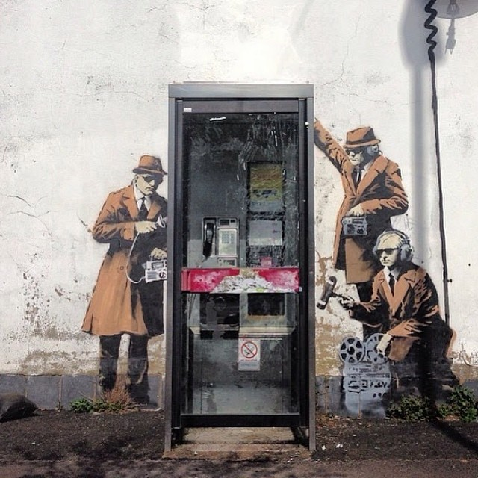
Street Art: Banksy

Slide 36
How did we get to this unexpected point?

Slide 37
How did we get to this unexpected point?
What happened over the past 25 years to get us here?

Slide 38
What Happened?
The commercialisation of the electronic messaging Internet
  The expansion from the academic and research stable to a public venture based largely on entrepreneurial activity

Slide 39
What Happened?
The internal re-building of the telco industry
  Active effort to engage with the Internet and integrate it into the telco service portfolio
    The Internet was not originally seen as a threat to voice – but it was seen as a threat to their services
  Active effort of the ISPs at the time to keep the telcos out!
  Regulatory confusion

Slide 40
What Happened?
The Web World
  De-geeking the Internet
  Adding pictures and sound!
  Lifting access capacity by the first orders of magnitude (Kilobits to Megabits)
  Web content revolution
  The rise of search
  The emergence of VOIP as a threat to the telco core

Slide 41
Then what?
Broadband Capacity meets Broadband Content – the rise of the streamers
  Noone truly expected that the Internet would take on broadcast television at the pace and volume that it has played out
  All of the capacity planning models for infrastructure engineering need to change
  New business relationships between CDNs and IAPs had to be forged

Slide 42
Then what?
ISP culling as volume economics places ever greater control over the access industry
  Profitability is no longer based on aggressive market expansion, but on cost management
  Volume wins in such a market, so the ISP industry aggregates up to a small (3 – 4) number of large providers in each national market
The assumptions of ubiquity and the “cloud”

Slide 43
Then What?
The iPhone!

Slide 44
Then What?
The mobile ”smart device” has changed the Internet in almost every way
  the rise of social networks as a shared commentary of work and play
  the rise of the cloud as an adjunct to the terminal device
  the assumption of network as a ubiquitous unlimited resource

Slide 45
So what are the issues?
The “new” Internet is now all mobile:
~2 BILLION devices shipped in 2015
50% of all visible devices on the Internet
75% of all access service ARPU $ is mobiles
So mobile access networks are the focus of “new” competition in the “new Internet”– right?

Slide 46
So what are the issues?
http://pluseurope.over-blog.com

Slide 47
So what are the issues?
Our expectations about what technology can and can’t achieve and reality sit on either side of an increasingly large credibility gap!

Slide 48
Expectations vs Reality
Terrabit was a “not in my lifetime – ever” dream
  We are now using 100Gb transmission systems
  1Tb systems will probably appear in the coming 2 – 4 years
  Surprisingly, its still called “Ethernet”
    And even more surprisingly we’ve been unable to figure out how to raise the packet MTU above 1,500 octets in an accepted standard manner!

Slide 49
Expectations vs Reality
IP was was the answer!
Yes, and No!
  We have moved back into maintained network segmentation state with MPLS foundations in most large networks
  The security issues with unmanaged endpoints and a non-segmented network were unworkable – so we addressed this by segmenting the network through “soft” circuit state overlays
  And its likely that this will continue with the work on SDN and Open Flow
  Hybrid virtual state network systems coupled with stateless packet datagrams are proving to be a resilient architecture for current networks

Slide 50
Expectations vs Reality
IPv6 was the answer!
Yes, and No!
  We could not conceive of a network that had run out of IP addresses – it seemed to be a contradictions in terms
  So we were all meant to switch over to IPv6 well before IPv4 collapsed
  Which we haven’t
  Which means that we are in an unanticipated environment that demands we run IPv4 and IPv6 without a clear end in sight

Slide 51
Expectations vs Reality
Every device needs its own unique IP address
  Well obviously that’s not the case!
  We managed to change this by changing the basic model of the network from a peer-to-peer mesh to a client/server architecture
  Clients did not need to use a dedicated address, and could share an address from a common pool using NATs
  NATs are everywhere today
  And now we are wondering just how far NATs can scale!

Slide 52
Expectations vs Reality
NATS are a roadbump in the evolution of IP
  It’s still unclear, but we are getting really good at running a NAT-based Internet!
  Applications are now NAT agile
  We are now pushing address sharing into the server side
    The Internet’s Name System is the last piece of cohesive glue
  It may be that nobody wants to rebuild the old peer IP network architecture, so we will be stuck with NATs forever!

Slide 53
Expectations vs Reality
NATs can scale infinitely
No they can’t
  But we just don’t know if they can scale up to the same point as IPv6!

Slide 54
Expectations vs Reality
We can stop spam!
No we can’t!
  We’ve tried:
    IP Black lists, DNS black lists, Grey Lists, White lists, Certification, Domain Keys, Content inspection, Data Analytics, rules, inferences, blocking, permission, regulation, legislation, industry codes of conduct, …
  It seems that no matter how high we build the wall, SPAM manages to get over it!
  And so far there is no solution in sight

Slide 55
Expectations vs Reality
We can “fix” Security
No we can’t!
  Does anyone even think that this is a solvable problem any more?
  The Internet is alive with malware, trojans, scanners, bots, ransomware, hackers, cyber criminals, cyber warfare,…
  And if this is a “war” then we’ve lost every battle so far!
  Complex systems appear to be vulnerable simply because they are complex
      And we have no idea how to live in this toxic environment
  So far all of us are just “feeling lucky”

Slide 56
Expectations vs Reality
Encryption gives you Security
No it doesn’t!
  It just changes the locus of attack
  And at the same time creates a deluded sense of security without the substance of assured robust security
  The current PKI Certificate framework used by Internet servers has been compromised many times, and will be compromised many more times
    But we just don’t want to change our behaviours

Slide 57
But
There is no Plan B, and no going back
We have passed the point of no return a long time ago
We are now completely reliant on this hyper-connected environment
We are now counting on Moore’s law forever: ever faster, ever cheaper, ever smaller, everywhere.
  Even though the silicon engineers continuously declaim that the end is nigh for Moore’s Law
We are now being driven by change, not driving change

Slide 58
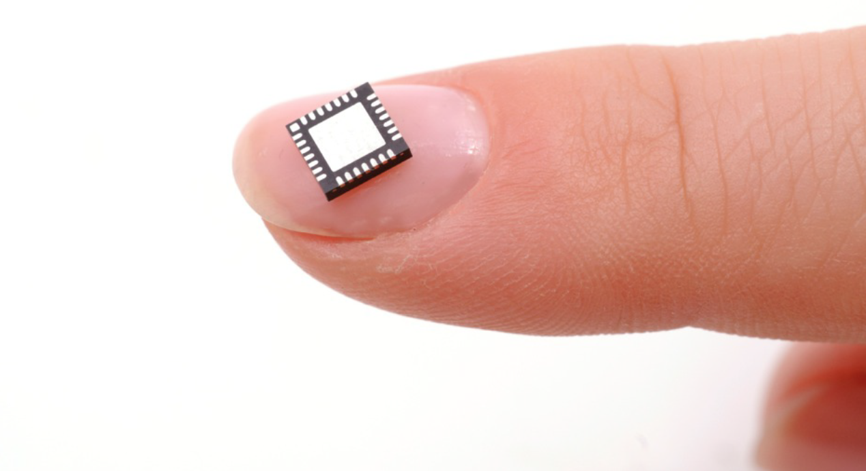
So what are the issues?

Slide 59
Carriage vs Content

Slide 60
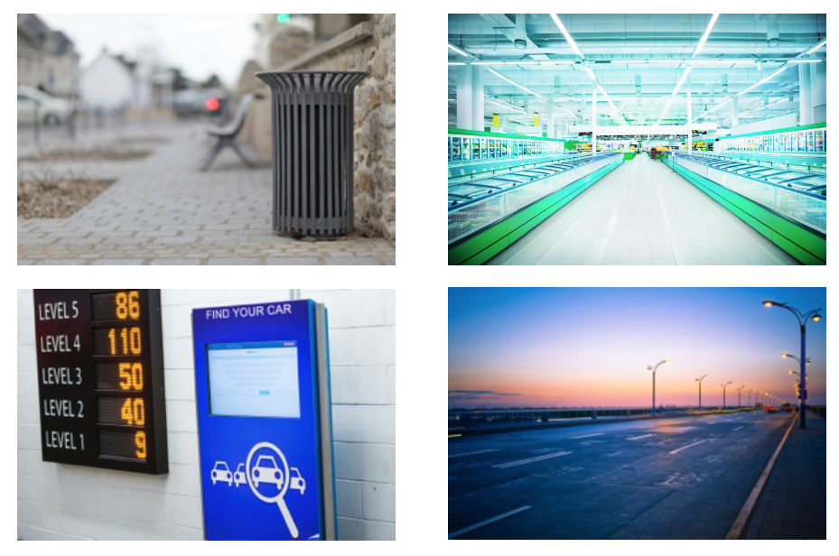
Silicon Ubiquity

Slide 61
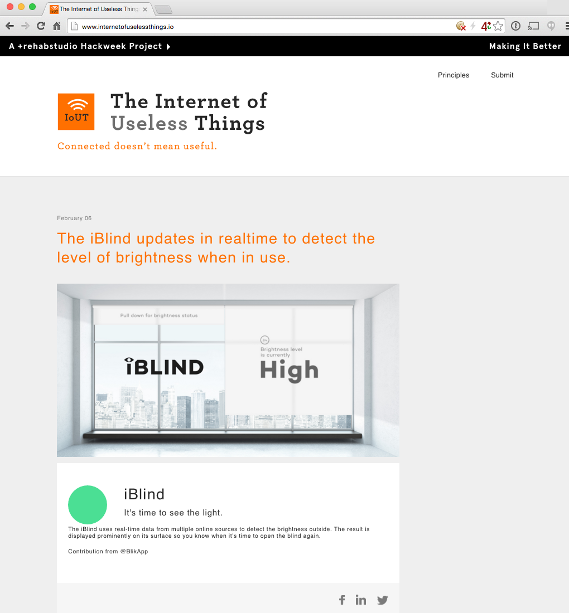
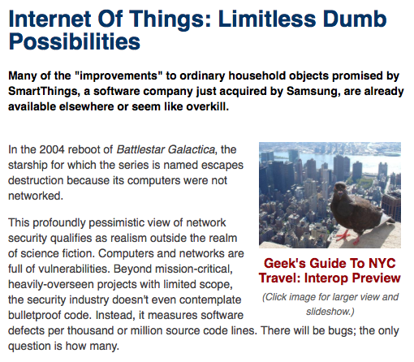
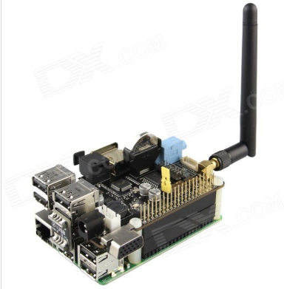
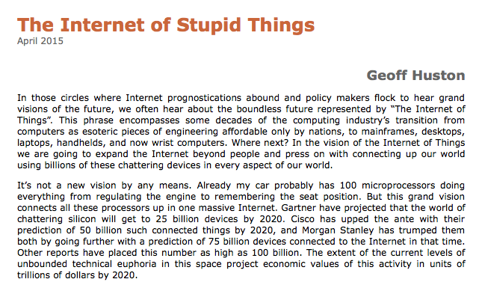
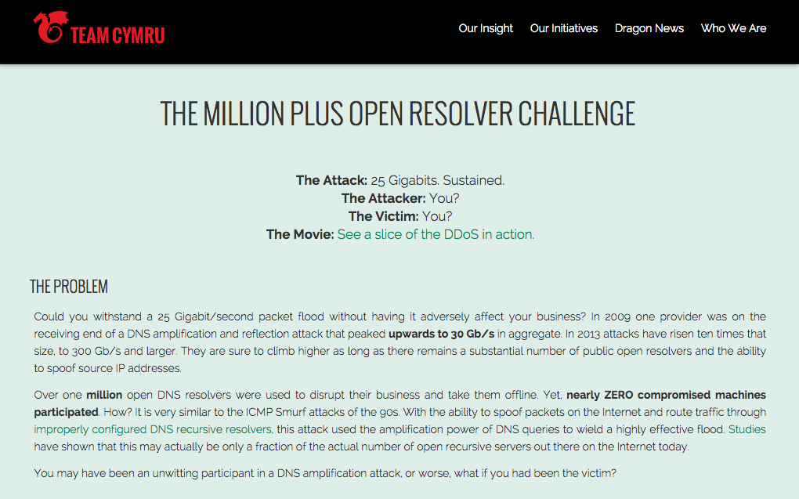
Silicon Stupidity

Slide 62
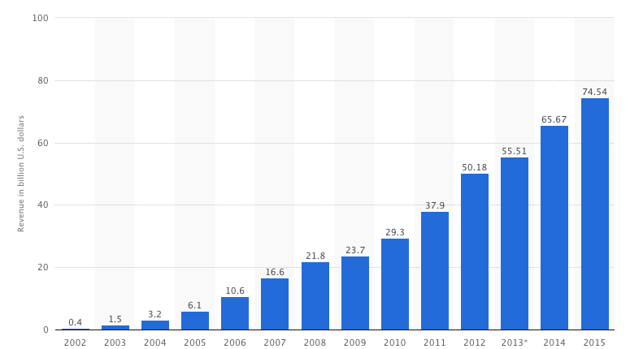
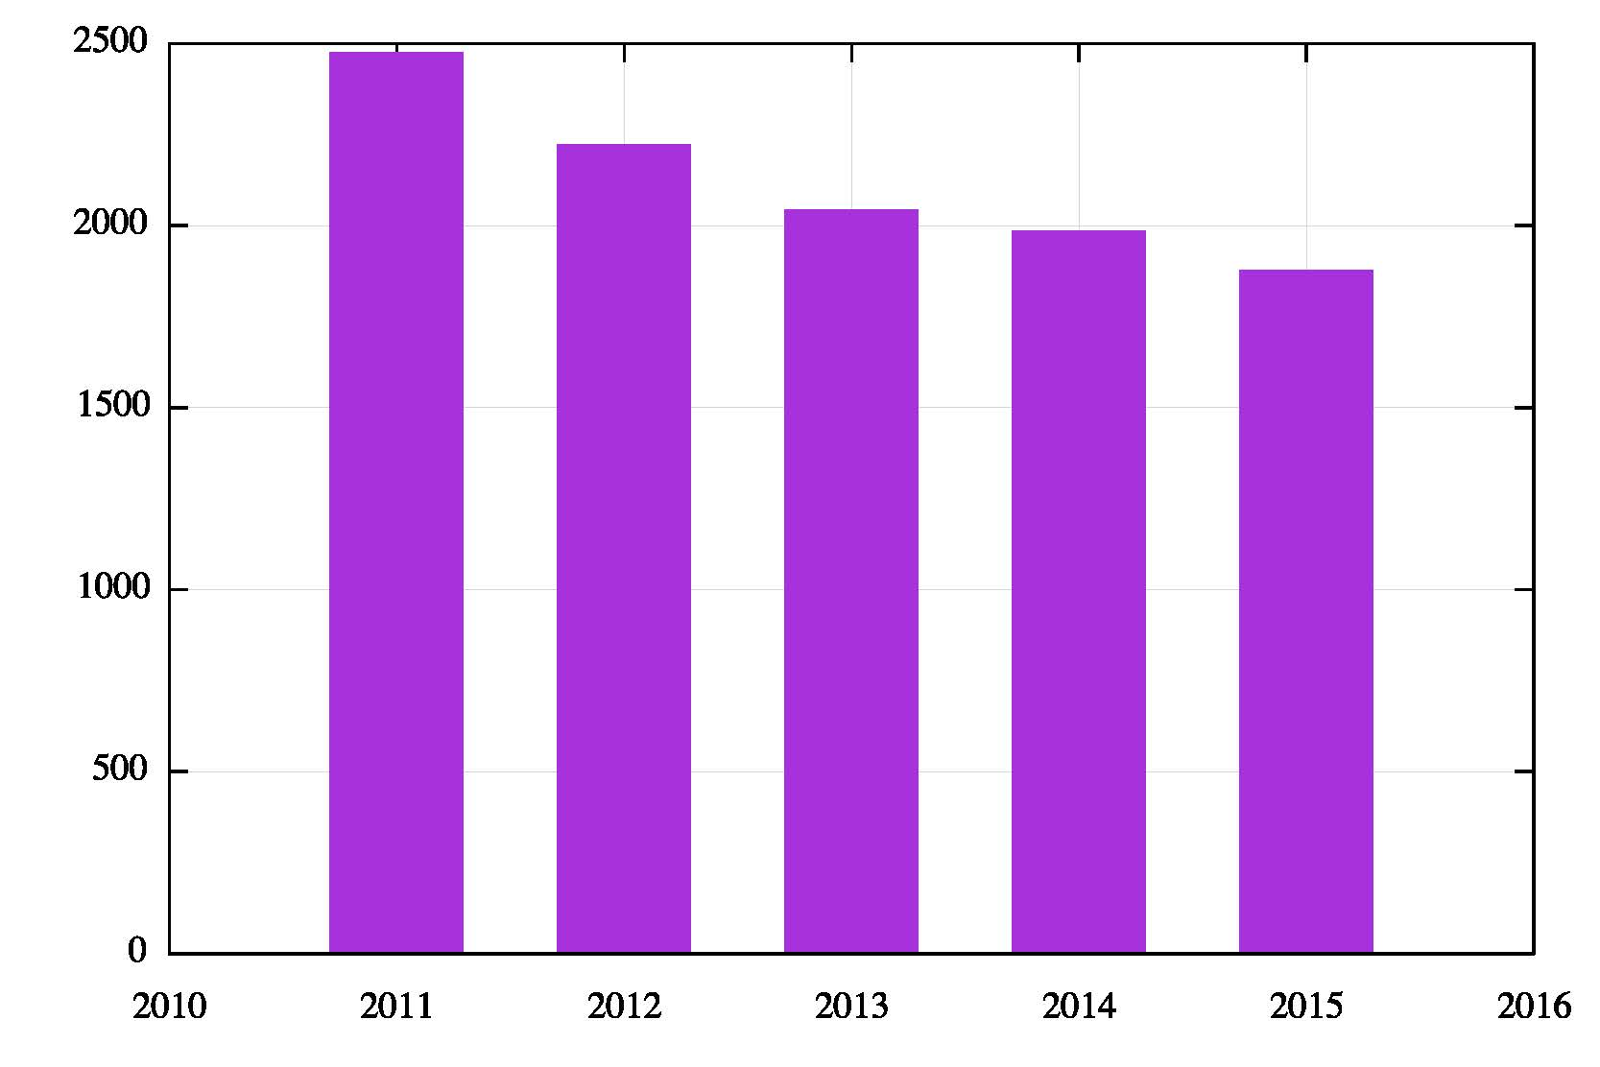
Out with the old and in with the new
The new product that is being marketed is now the online individual user – mass market media channels are now declining in relevance
Fairfax Media Annual Revenue: 2011 - 2015
Google Annual Revenue: 2002 - 2015

Slide 63
Nowhere and Nothing to Hide Any more!

Slide 64
So where does it head?
In 1990, when Peter and I were connecting up campuses in Australia, our world had:
  mobile phones the size of briefcases
  “portable” computers that weren’t even luggable!
  cameras that loaded film
  “real” computers that were multi-million dollar investments with cluster of work bees to tend them
  “technology” as a skilled occupation undertaken by a small cadre of educated professional engineers
  And it may have had Microsoft and Apple, but it had no Google!
Much of that world has vanished!

Slide 65
So where does it head?
What has replaced it is both oddly familiar and strangely alien at the same time:
  telephones you talk to, not talk through
  cameras that take the picture you actually wanted to take
  cars that can drive you, rather than cars that you drive
And most of this took just 25 years!

Slide 66
So where does it head?
So what can we expect in 25 years time?

Slide 67
So where does it head?
So what can we expect in 25 years time?
Firstly, it’s not gong to stop here!

Slide 68
So where does it head?
So what can we expect in 25 years time?
Firstly, it’s not gong to stop here!
But after saying that, what will happen in 25 years is far harder to predict!

Slide 69
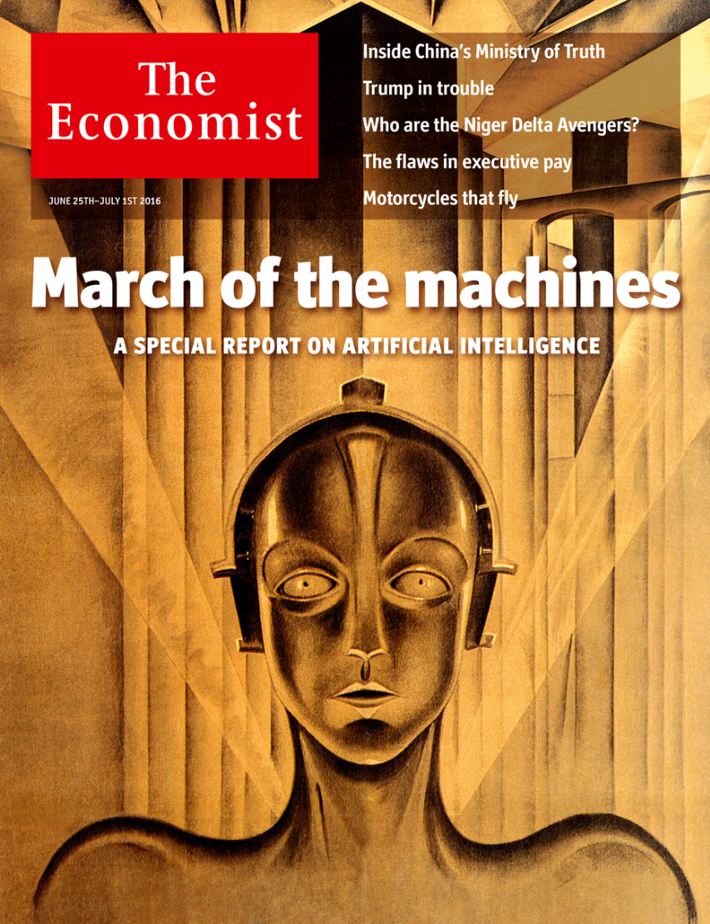
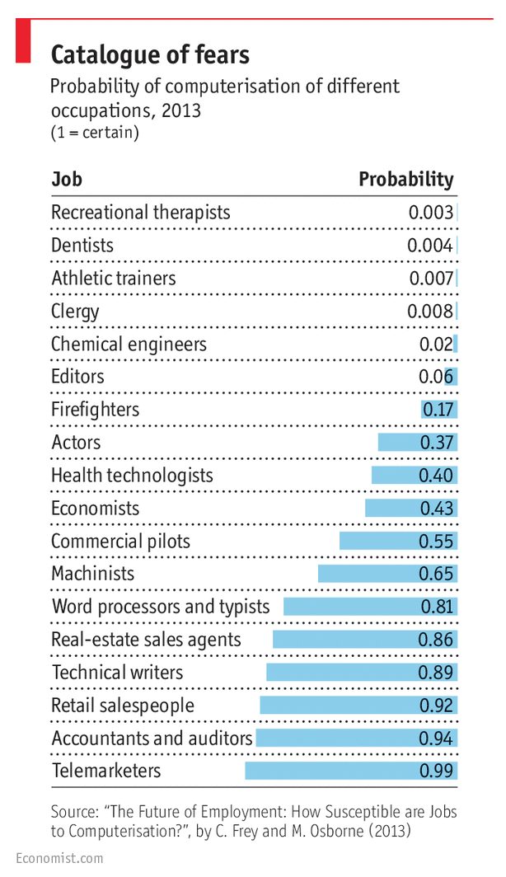
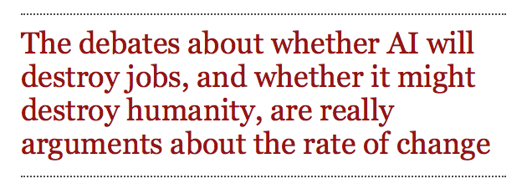
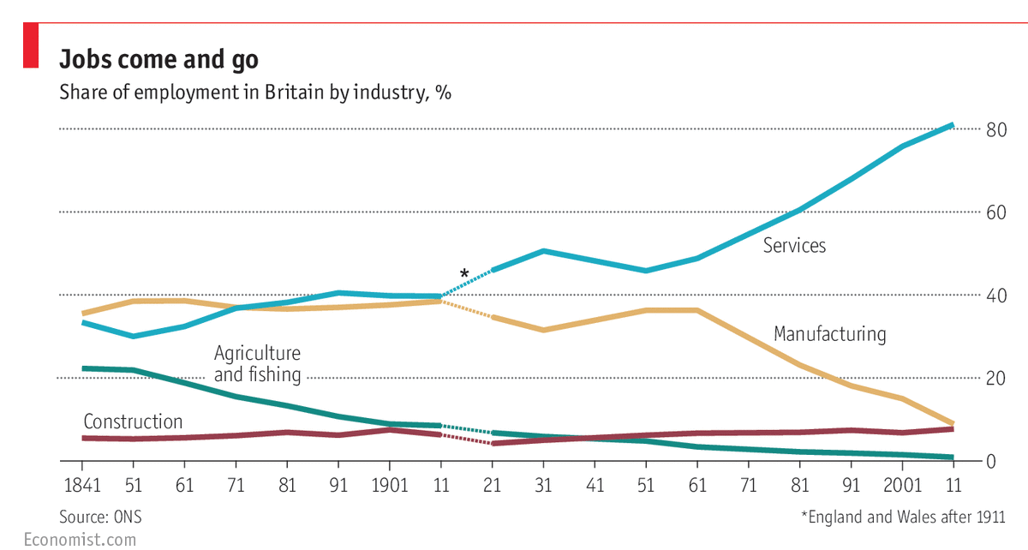
“Smart” futures
There will be more machines, and more powerful machines
These automated systems will focus on human activities, and they will be driving to the point of using machinery rather than human labour for a myriad of current activities
The focus on the elements of computing and network requirements of these systems will probably shift from means to outcomes
The Economist, June 2016

Slide 70
Thanks!

